Slide 1
Tailored Care Management:
Overview of the AMH+ and CMA Model
March 26, 2021
Kelly Crosbie, MSW, LCSW,
Director, Quality & Population Health
Gwen Sherrod, MBA, MHA
Program Manager, Tailored Care Management
NC Medicaid

Slide 2
Agenda
Tailored Care Management Model Overview
Application Process for AMH+ Practices and CMAs
Overview/Examples of Medicaid Education
Q & A

Slide 3
Medicaid Managed Care Overview
Over the next two years, North Carolina will transition from a predominantly fee-for-service delivery system to Medicaid managed care. With this transition, the state will offer four types of managed care products that will provide integrated, whole-person care.
Standard Plan
Standard Plans will provide integrated physical health, behavioral health, pharmacy, and long-term services and supports to the majority of Medicaid beneficiaries, as well as programs and services that address other unmet health related resource needs. Standard Plans will launch in July 2021.
BH I/DD Tailored Plan
Behavioral Health (BH) Intellectual/ Developmental Disability (I/DD) Tailored Plans will provide the same services as Standard Plans, as well as additional specialized services for individuals with significant behavioral health conditions, I/DDs, and traumatic brain injury, as well as people utilizing state-funded and waiver services. The Department released the BH I/DD Tailored Plan Request for Applications (RFA) on November 13, 2020 and expects these plans to launch in July 2022.
Specialized Plan for Children in Foster Care
A Specialized Plan for Children in Foster Care will be available to children in foster care and will cover a full range of physical health, behavioral health, and pharmacy services.
EBCI Tribal Option
The Eastern Band of Cherokee Indians (EBCI) Tribal Option will be available to tribal members and their families and will be managed by the Cherokee Indian Hospital Authority (CIHA).

Slide 4
DHHS is currently engaged in Listening Sessions on the TCM model.
DHHS will be releasing more information on the TCM model for feedback prior to application deadline.
Tailored Care Management Model

Slide 5
Tailored Care Management Model
Tailored Care Management is the primary care management model for BH I/DD Tailored Plans, and operates on the key principle that physical health, behavioral health, and I/DD-related needs are integrated through the care team.
Overarching Principles
Roles and Responsibilities of Care Managers
Management of beneficiary needs during transitions of care
High-risk care management
Chronic care management
Management of high-risk social environments
Identification of beneficiaries in need of care management
Development of care management assessments/care plans
Coordination of services
Broad access to care management
Single care manager taking an integrated, whole-person approach
Person- and family-centered planning
Provider-based care management
Community-based care management
Community inclusion
Choice of care managers

Slide 6
Three Approaches to Delivering Tailored Care Management
Department of Health and Human Services
Establishes care management standards for BH I/DD Tailored Plans aligning with federal Health Home requirements.
The BH I/DD Tailored Plan will act as the Health Home and will be responsible for meeting federal Health Home requirements
BH I/DD Tailored Plan
(Health Home)
Care Management Approaches
BH I/DD Tailored Plan beneficiaries will have the opportunity to choose among the care management approaches;
all must meet the Department’s standards and be provided in the community to the maximum extent possible.
Approach 1:
“AMH+” Primary Care Practice
Practices must be certified by the Department to provide Tailored Care Management.
Approach 2:
Care Management Agency (CMA)
Organizations eligible for certification by the Department as CMAs include those that provide BH or I/DD services.
Approach 3:
BH I/DD Tailored Plan-Based Care Manager
The Department will allow – but not require – AMH+ practices and CMAs to work with a CIN or other partner to assist with the requirements of the Tailored Care Management model,
within the Department’s guidelines.

Slide 7
Glide Path to Provider-based Care Management
Tailored Care Management will require a multiyear effort to enhance the workforce at the AMH+ and CMA level. The Department will establish a “glide path” to guide the growth of provider-based capacity.
Numerator:
Denominator:
Number of members actively engaged in Tailored Care Management provided by care managers based in AMH+ practices or CMAs
certified by the Department
X%
x 100
=
Total number of members actively engaged in
Tailored Care Management
Department will compare X to annual targets that will be measured during the 1st quarter of the subsequent contract year:
 | Year 0 (Mid 2021) | Year 1 (Mid 2022) | Year 2 (Mid 2023) | Year 3 (Mid 2024) | Year 4 (Mid 2025)
Target percentage of beneficiaries served by care managers/ supervisors based in AMH+ practice/CMA | N/A | 30% | 45% | 60% | 80%
The Department believes that provider- and community-based care management
is critical to the success of fully integrated managed care.
Notes:
https://www.ips.state.nc.us/IPS/AGENCY/PDF/13929701.pdf

Slide 8
Care Management Process Flow
Care management design aligns with Standard Plan requirements to the greatest extent possible, but in several areas the Department has built special guardrails
to meet the unique needs of the BH I/DD Tailored Plan population.
BH I/DD Tailored Plan auto-enrolls beneficiary into Tailored Care Management; beneficiary has ability to opt out
CMA, AMH+, or BH I/DD Tailored Plan care manager facilitates outreach and engagement
Care manager convenes a multidisciplinary care team
Enrollment
Care Management Assignment
Engagement into Care Management
Care Management
Comprehensive Assessment
Care Team Formation and Person-Centered Care Planning
Ongoing Care Management
BH I/DD Tailored Plan assigns each beneficiary to CMA, AMH+, or BH I/DD Tailored Plan for care management; that organization assigns beneficiary to a specific care manager*
Care management comprehensive assessment informs care plan or Individual Support Plan (ISP); care manager facilitates completion of care management comprehensive assessment
Required care management activities will include requirements for contacts, care transitions, and unmet health-related resource needs
*Innovations and TBI waiver beneficiaries will have the choice of keeping their current care coordinators if the care coordinators meet all of the care manager requirements to serve BH I/DD Tailored Plan beneficiaries and federal requirements for conflict-free case management.

Slide 9



Payment for Care Management
AMH+ practices and CMAs will be paid standardized (fixed) PMPM rates, tiered by acuity. These rates will be significantly higher than Standard Plan care management rates.
Acuity Tier | Illustrative Rates in RFA
BH, Low Acuity | $160
BH, Moderate Acuity | $260
BH, High Acuity | $360
I/DD or TBI, Low Acuity | $90
I/DD or TBI, Moderate Acuity | $260
I/DD or TBI, High Acuity | $320
The Department pays a care management PMPM separate from the capitation rate based on care management claims submitted for enrollees actively engaged in care management.
The Department
BH I/DD Tailored Plan pays AMH+ practices and CMAs PMPM for care management, tiered by acuity level; submits claims for care management to the Department. Retains care management PMPM if providing care management directly.
The Department will release more information about payment rates in the future.
BH I/DD Tailored Plan
(Health Home)
Key
Payments
Claims
AMH+ practice or CMA submits monthly claims to BH I/DD Tailored Plans for care management payments.
AMH+ Practice/CMA
Notes:
https://www.ips.state.nc.us/IPS/AGENCY/PDF/13929705.pdf

Slide 10
Application Process for
AMH+ Practices and CMAs

Slide 11
AMH+/CMA Certification Process is Open!
The AMH+ and CMA certification process will include desk reviews and site visits in three rounds prior to July 2022 BH I/DD Tailored Plan launch. Providers will have additional opportunities to apply for certification post-launch.
Round | Application Deadline | Desk Reviews/Site Visits
1 | June 1, 2021 | Desk reviews: June – August 2021* Site visits: August – September 2021*
2 | Spring 2021 | Desk reviews: Summer 2021* Site visits: Fall 2021*
3 | Fall 2021 | Desk reviews: Fall 2021* Site visits: Winter 2022*
Providers can submit an application to be considered for certification as an AMH+ or CMA in the first round from now through June 1, 2021. The application form is available at https://files.nc.gov/ncdma/Revised-Tailored-Care-Management-Application-Questions20201202.pdf and should be submitted to Medicaid.TailoredCareMgmt@dhhs.nc.gov.
*proposed dates may change

Slide 12
AMH+ and CMA Certification Process
For the period prior to BH I/DD Tailored Plan launch, DHHS will facilitate desk reviews and site visits to determine whether a provider organization should be certified to perform
Tailored Care Management.
DHHS Role: DHHS has responsibility for stages 1-3, culminating in a certification decision for each application.
BH I/DD Tailored Plan Role (LME-MCO): Oversight transitions to plan level.
STAGE 1
Provider Application
STAGE 2
Desk Review
STAGE 3
Site Visits
STAGE 4
Readiness Review/ Contracting
Desk Review: The Department will review each written application to determine whether the organization has the potential to satisfy the full criteria at BH I/DD Tailored Plan launch.
Site Visit: The Department will arrange to conduct one or more site visits with providers that “pass” the desk review to drive a final decision on certification, and to increase understanding of each organization’s capacity, strengths, and areas for improvement, including need for capacity building funding.
The AMH+ and CMA certification process is separate from the Medicaid enrollment process.

Slide 13
Role of CIN or Other Partners in Application Process
In response to comments from stakeholders, the Department has decided to allow a pathway for CINs or Other Partners to answer certain questions, if applicable to an organization’s application.
How may CINs or Other Partners Serve AMH+ practices and CMAs?
How does the certification process work if a provider has not yet decided whether to contract with a CIN or Other Partner?
Supporting application process by completing the CIN or Other Partner Supplement
Providing local care management staffing, functions and services
Supporting AMH+ and CMA analytics and data integration
Assisting in the contracting process or directly contracting with BH I/DD Tailored Plans on behalf of AMH+ practices/CMAs
The Department will certify individual AMH+ practices and CMAs, not CINs
Organizations that have not yet decided whether/how to affiliate with a CIN or Other Partner may begin the application process now
  Final certification decision prior to BH I/DD Tailored Plan launch will include assessment of how roles and responsibilities will be shared between provider and CIN or Other Partner
A “CIN or Other Partner” is an organization with which an AMH+ or CMA may be affiliated that helps the AMH+ or CMA meet the requirements of the model.

Slide 14
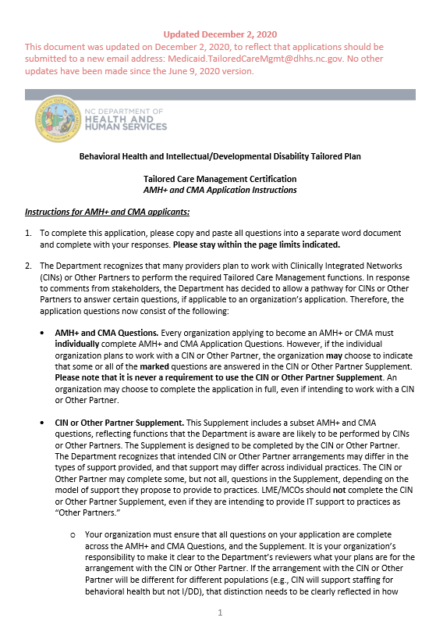
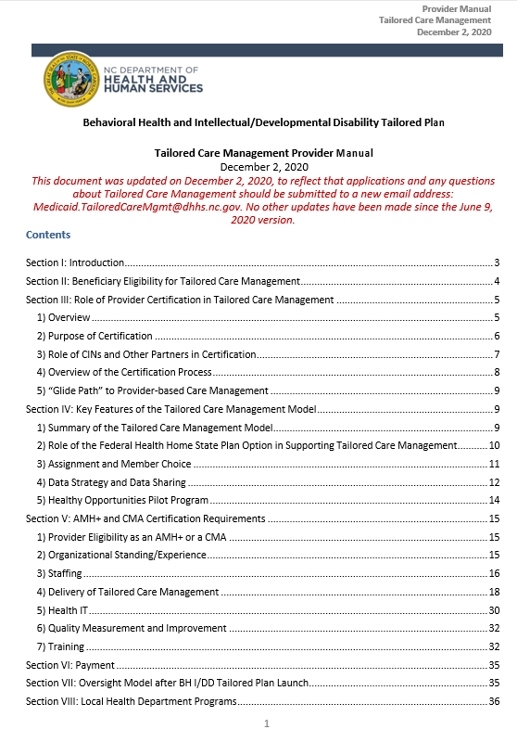
Certification Requirements Overview
The AMH+ and CMA certification application will assess whether organizations are credibly on track to deliver Tailored Care Management by BH I/DD Tailored Plan launch.
Requirements:
1
Meet eligibility definitions as an AMH+ or CMA
Show appropriate organizational standing/experience
Show appropriate staffing
Demonstrate the ability to deliver all required elements of the Tailored Care Management model
Meet health IT requirements
Meet quality measurement and improvement requirements
Participate in required training (occurs after initial certification)
2
3
4
5
6
7
Organizations do not have to be fully ready now, but must be able to describe their plans to achieve readiness.
The Department intends to provide “capacity building” funding for provider organizations. More detail on this opportunity will be forthcoming.
Organizations should cross-reference the Tailored Care Management Provider Manual when completing the Application Form.

Slide 15

1. Eligibility
1. Eligibility
2. Experience
3. Staffing
4. Tailored CM
5. Health IT
6. Quality
7. Training
Advanced Medical Home Plus (AMH+)
Care Management Agency (CMA)
Definition: Primary care practices actively serving as AMH Tier 3 practices, whose providers have experience delivering primary care services to the BH I/DD Tailored Plan eligible population or can otherwise demonstrate strong competency to serve that population. To demonstrate experience and competency to serve the BH I/DD Tailored Plan eligible population, each AMH+ applicant must attest that it has a patient panel with at least 100 active Medicaid patients who have an SMI, SED, or severe SUD; an I/DD; or a TBI.
AMH+ practices may, but are not required to, offer integrated primary care and behavioral health or I/DD services.
To be eligible to become an AMH+, the practice must intend to become a network primary care provider for BH I/DD Tailored Plans.
Definition: Provider organizations with experience delivering behavioral health, I/DD, and/or TBI services to the BH I/DD Tailored Plan eligible population, that will hold primary responsibility for providing integrated, whole-person care management under the Tailored Care Management model.
To be eligible to become a CMA, an organization’s primary purpose at the time of certification must be the delivery of NC Medicaid, NC Health Choice, or State-funded services, other than care management, to the BH I/DD Tailored Plan eligible population in North Carolina. The “CMA” designation is new and will be unique to providers serving the BH I/DD Tailored Plan population.
AMH+ practices or CMAs must not be owned by, or be subsidiaries of, BH I/DD Tailored Plans.

Slide 16
Certification will be Organized by Population
1. Eligibility
2. Experience
3. Staffing
4. Tailored CM
5. Health IT
6. Quality
7. Training
Organizations must indicate the population(s) for which they are applying to be certified.
Mental Health and Substance Use Disorder (SUD)
Adult
Child/adolescent
I/DD
TBI
Innovations Waiver
TBI Waiver
Co-occurring I/DD and Behavioral Health
Adult
Child/adolescent
Certification will also be by BH I/DD Tailored Plan region, although one provider application may cover multiple regions.

Slide 17
2. Organizational Standing/Experience
1. Eligibility
2. Experience
3. Staffing
4. Tailored CM
5. Health IT
6. Quality
7. Training
Certification Criteria | Key Application Content | What DHHS will be Looking For
2.1. Relevant experience | Information provided about current scope of services and populations Description of organization’s history and length of experience | Alignment of prior experience with population: generally, at least 2 year history of services aligned with population served, in NC Integration of mental health and SUD for BH agencies
2.2. Provider relationships and linkages | Description of current contracts and arrangements with other providers, including those that could play the “clinical consultant” role | Relationships/formal linkages in place Plan for strengthening relationships for “clinical consultant” roles
2.3. Capacity and sustainability | Attachment of most recently audited financial report Description of leadership team for Tailored Care Management | Evidence of financial capacity (e.g., balanced budget) Clear leadership roles and accountability
2.4. Oversight | Board approval Organizational chart Description of how management and oversight will occur | Appropriate structures in place to oversee the Tailored Care Management model Strong governance with appropriate executive and management structure and approval of the application

Slide 18
Category 3: Staffing
1. Eligibility
2. Experience
3. Staffing
4. Tailored CM
5. Health IT
6. Quality
7. Training
By BH I/DD Tailored Plan launch, care managers at AMH+ practices and CMAs
must meet minimum requirements below:
Care Management Staff | Minimum Requirements
Care managers serving all members | A bachelor’s degree in a field related to health, psychology, sociology, social work, nursing, or another relevant human services area, or licensure as a registered nurse (RN); and Two years of experience working directly with individuals with behavioral health conditions (if serving members with behavioral health needs) or with an I/DD or a TBI (if serving members with I/DD or TBI needs); and For care managers serving members with LTSS needs: two years of prior LTSS and/or HCBS coordination, care delivery monitoring, and care management experience, in addition to the requirements cited above. (This experience may be concurrent with the two years of experience working directly with individuals with behavioral health conditions, an I/DD, or a TBI, above.)
Supervising care managers serving members with behavioral health conditions | A master’s-level fully Licensed Clinical Social Worker (LCSW), fully Licensed Clinical Mental Health Counselor (LCMHC), fully Licensed Psychological Associate (LPA), fully Licensed Marriage and Family Therapist (LMFT), or licensure as an RN; and Three years of experience providing care management, case management, or care coordination to the population being served.
Supervising care managers serving members with I/DD or a TBI (must have one of the following minimum qualifications) | A bachelor’s degree in a field related to health, psychology, sociology, social work, nursing, or another relevant human services area and five years of experience providing care management, case management, or care coordination to complex individuals with I/DD or TBI; or A master’s degree in a field related to health, psychology, sociology, social work (e.g., LCSW), nursing, or another relevant human services area, or licensure as an RN and three years of experience providing care management, case management, or care coordination to complex individuals with an I/DD or a TBI.

Slide 19
Category 4: Delivery of Tailored Care Management
1. Eligibility
2. Experience
3. Staffing
4. Tailored CM
5. Health IT
6. Quality
7. Training
Certification Criteria | Key Application Content | What DHHS will be Looking For
4.1. Policies and procedures for communication with members | Attestation that the organization will develop policies | [Attestation]
4.2. Capacity to engage with members through frequent contact | Description of strategy to meet minimum contact requirements | Clear strategy for how the organization will meet each of the minimum requirements and tailor to the population being served.
4.3. Care management comprehensive assessments and reassessments | Description of approach to care management comprehensive assessment
4.4. Care plans and Individual Support Plans (ISPs) | Description of approach to care plans/ISPs
4.5. Care teams | Description of approach to developing care team and convening regular conferences, including foreseen challenges Description of strategy to share and manage access to patient information

Slide 20
Category 4: Delivery of Tailored Care Management
1. Eligibility
2. Experience
3. Staffing
4. Tailored CM
5. Health IT
6. Quality
7. Training
Certification Criteria | Key Application Content | What DHHS will be Looking For
4.6. Required components of Tailored Care Management | Description of approach to meet each of the required components Attestation to provide or arrange for 24/7 coverage for services, consultation or referral, and treatment for emergency medical conditions | Experience and capabilities for: Care coordination Twenty-four hour coverage Ensuring annual physical exam is carried out Continuous monitoring Medication monitoring System of Care Individual and family supports Health promotion
4.7. Addressing unmet health-related resource needs | Description of relationships with community organizations Description of experience in addressing unmet health-related resource needs | Experience and competency providing referral, information and assistance
4.8. Transitional care management | Attestation of access to ADT data Description of methodologies to respond to ADT data Description of transition approaches for special populations and diversion from institutional settings | Experience and capability managing transitions Plan for achieving ADT access, if not in place Evidence of an approach to identifying and diverting members who are at risk of requiring care in an adult care home or an institutional setting
4.9. Innovations and TBI Waiver Care Coordination (if applicable) | Description of approaches to address additional requirements if serving this population | Experience serving this population

Slide 21
Category 5: Health Information Technology
1. Eligibility
2. Experience
3. Staffing
4. Tailored CM
5. Health IT
6. Quality
7. Training
Certification Criteria | Key Application Content | What DHHS will be Looking For
5.1. Use an Electronic Health Record (EHR) | Attestations that EHR is in place Description of EHR | EHR must be in place at the time of application
5.2. Use a care management data system | Description of care management data system Description of how claims/encounter data will be imported, curated, and analyzed | Description of system in place or planned at the organization and/or proposal to work with BH I/DD Tailored Plan or CIN Note: no requirement to use the BH I/DD Tailored Plan’s care management data system
5.3. Use ADT information | Attestation of access to ADT data Description of methodologies to respond to ADT data | Plan for achieving ADT access, if not in place today
5.4. Use NCCARE360 | [Use of NCCARE360 is not required now, but will be required when the application is certified as being fully deployed].
5.5. Risk stratify the population under Tailored Care Management beyond acuity tiering | [Currently optional] Encouraged, and required from Year Three of BH I/DD Tailored Plans onwards

Slide 22
1. Eligibility
2. Experience
3. Staffing
4. Tailored CM
5. Health IT
6. Quality
7. Training
AMH+ Practice and CMA Dataflows
BH I/DD Tailored Plan to AMH+ and CMA Dataflows
BH I/DD Tailored Plans will be expected to share the following data in a machine-readable format with AMH+ practices, CMAs, or their designated CINs or Other Partners, for their attributed members to support Tailored Care Management:
Member assignment information, including demographic data and any clinical relevant and available eligibility information
Member claims/encounter data, including historical physical (PH), behavioral health (BH), and pharmacy (Rx) claims/encounter data with new data delivered monthly (PH/BH) or weekly (Rx)
Acuity tiering and risk stratification information
Quality measure performance information at the practice level (format TBD)
Other data or information that may be used to support Tailored Care Management (e.g., previously established care plans, ADT data, historical member clinical information)
Additional AMH+ and CMA Data Requirements
AMH+ practices and CMAs will also be expected to acquire and use the following data to support Tailored Care Management:
Admission, Discharge, and Transfer (ADT) information
Relevant clinical information for population health care management processes, including data from the care management comprehensive assessment, care plan, and referral data

Slide 23
Category 6: Quality Measurement and Improvement
1. Eligibility
2. Experience
3. Staffing
4. Tailored CM
5. Health IT
6. Quality
7. Training
Certification Criteria | Key Application Content | What DHHS will be Looking For
6. Ability to use data to drive internal quality improvement through quality measurement and continuous quality improvement (CQI) | Description of plan to evaluate care management systems, processes, and services (internal QI) Description of plan to participate in quality measure documentation and data analysis (i.e., how the provider would use quality measure data from the BH I/DD Tailored Plan; or gather information to share with the BH I/DD Tailored Plan as needed) | Approach for using internal data to drive improvement using a systematic process Experience using and reporting quality measures

Slide 24
Category 6: Quality Measurement and Improvement
1. Eligibility
2. Experience
3. Staffing
4. Tailored CM
5. Health IT
6. Quality
7. Training
After launch of BH I/DD Tailored Plans, AMH+ practices and CMAs will be required to gather, process, and share data with BH I/DD Tailored Plans – as well as use data shared by BH I/DD Tailored Plans – for the purpose of quality measurement and reporting.
Federal Health Home Quality Measures
Adult Body Mass Index (BMI) Assessment
Prevention Quality Indicator (PQI) 92: Chronic Condition Composite
Care Transition – Transition Record Transmitted to Health Care Professional
Follow-Up After Hospitalization for Mental Illness
Plan All-Cause Readmission Rate
Screening for Clinical Depression and Follow-Up Plan
Initiation and Engagement of Alcohol or Other Drug (AOD) Dependence Treatment
Controlling High Blood Pressure
Measures additional to the above federally-required ones are on the next slide.

Slide 25
Category 7: Training
1. Eligibility
2. Experience
3. Staffing
4. Tailored CM
5. Health IT
6. Quality
7. Training
Each BH I/DD Tailored Plan will design and implement a training plan,
within DHHS guidelines on the topics that must be covered.
Certification Criteria | Key Application Content | What DHHS will be Looking For
7. Training | Attestation of intention to complete required trainings | Ensure care managers and supervisors will complete required trainings on: BH I/DD Tailored Plan eligibility and services Whole-person health and unmet resource needs Community integration Components of Health Home care management Health promotion Other care management skills Additional trainings for care managers and supervisors serving the following populations: Members with I/DD or TBI Children Pregnant and postpartum women with SUD or SUD history Members with LTSS needs

Slide 26

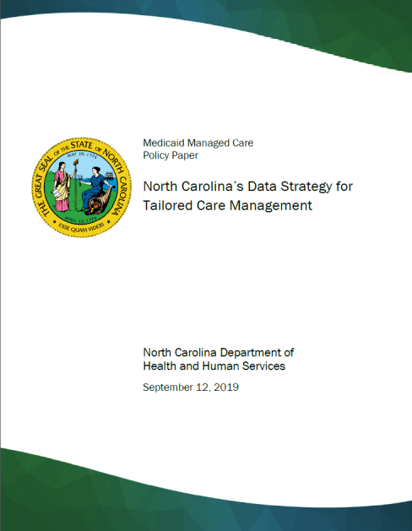
Information about the Tailored Care Management Model
Key documents can be found on the NC DHHS Medicaid webpage. Organizations should submit applications to become AMH+ practices or CMAs to Medicaid.TailoredCareMgmt@dhhs.nc.gov.
May 2019: Concept Paper
September 2019:
Data Strategy Paper
June/December 2020*:
Final Provider Manual and Application Questions
*In December 2020, the Department made minor updates to the Provider Manual and application questions released in June 2020 to reflect an updated email address for submitting applications.

Slide 27
Member Outreach Prior to Launch

Slide 28


Communications & Engagement
NC Medicaid engages beneficiaries through:
  Medicaid Contact Center
    888-245-0179
  Website updates and social media
      https://medicaid.ncdhhs.gov/transformation
  Paid advertising
    Radio, TV, web, social media (English and Spanish)

Slide 29
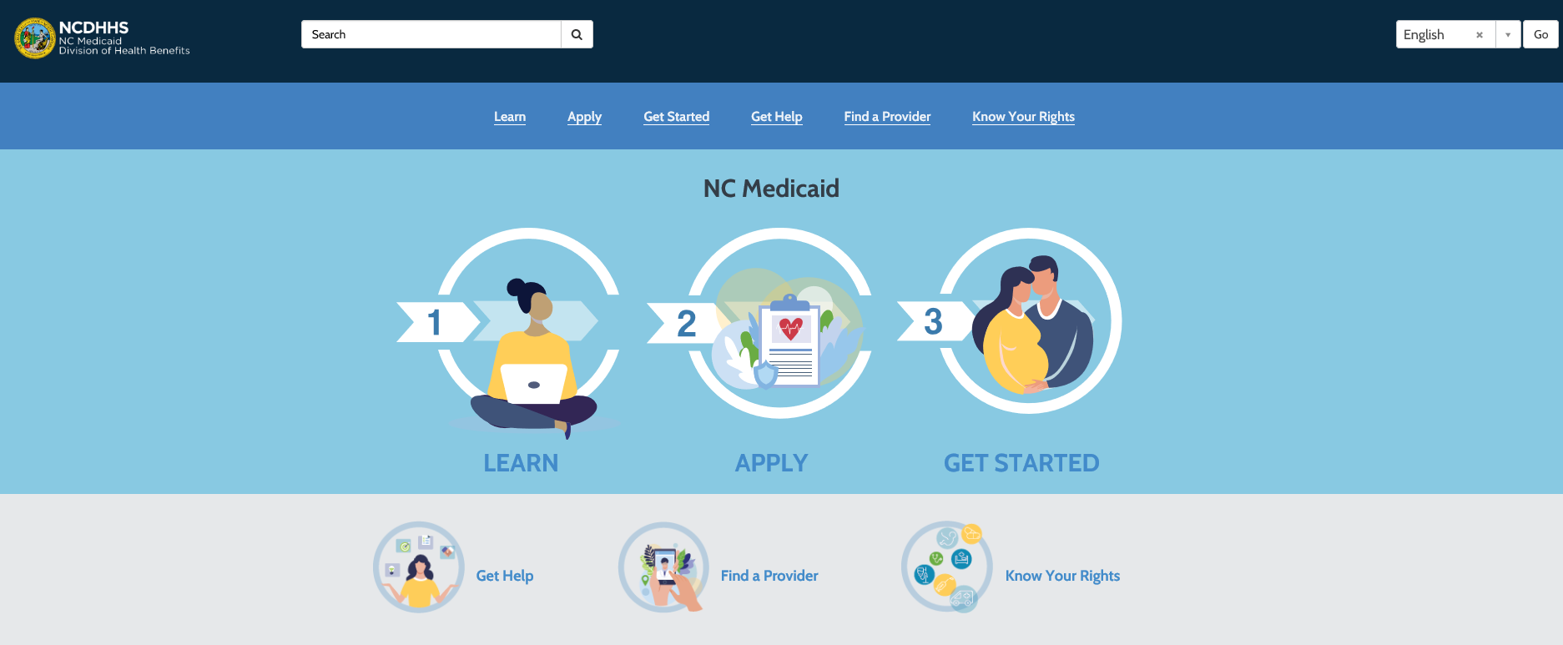
NC Medicaid Beneficiary Portal
An online portal for North Carolinians receiving or wanting to apply for Medicaid. The portal provides Medicaid resources in an easy-to-use web platform. The Help Center Assistant search feature guides users to topics of interest to them.
  Medicaid Beneficiary Portal: medicaid.ncdhhs.gov/beneficiaryportal

Slide 30
Beneficiary Portal Features
Available in English and Spanish
Provides Medicaid resources in an easy-to-use web platform
Includes Medicaid Managed Care
information
Offers new educational materials regarding telehealth services to help beneficiaries feel more confident accessing health care in a virtual format during COVID-19 and beyond
Includes a Help Center Assistant search feature that guides users to the most applicable topics of interest
Will expand to include personalized account views, single sign-on access and integration with NC FAST and other systems and offer real-time assistance via bi-lingual live agent chat capability
Notes:
Debra

Slide 31

NC Medicaid Ombudsman
    Launching April 15th
    ncmedicaidombudsman.org
    877-201-3750
Key Services
Information and Education to inform beneficiaries of their rights and to help answer questions over the phone, website, email, by mail and in person
Issue Resolution and Management as the central resource to resolve issues within the Medicaid Managed Care delivery system
Referrals to support beneficiaries' access to care in collaboration with other resources including State agencies, Department partners, community-based advocacy and legal service organizations
Trend Monitoring to identify trends or systemic issues in delivery system performance
Notes:
Angie (LANC)
This program is separate and distinct from the Long-Term Care Ombudsman Program.

Slide 32


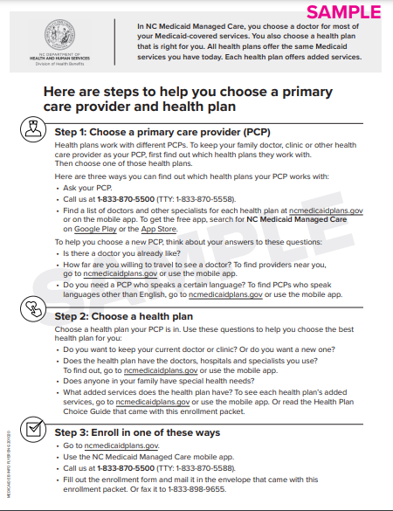
Beneficiary Communication
These transition notices did NOT go to Tailored Plan members, but similar ones will prior to BH/IDD TP Launch
Transition Notices
Information Sheet
Samples are available for download in the County Playbook on our website
medicaid.ncdhhs.gov/transformation

Slide 33
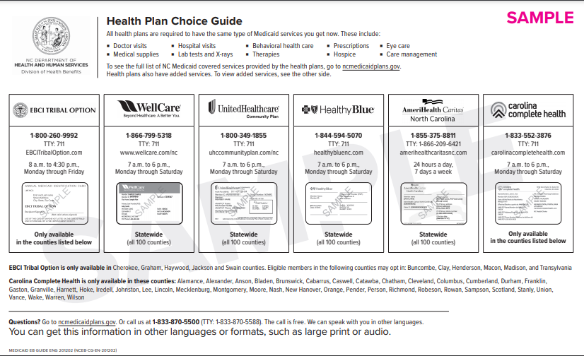
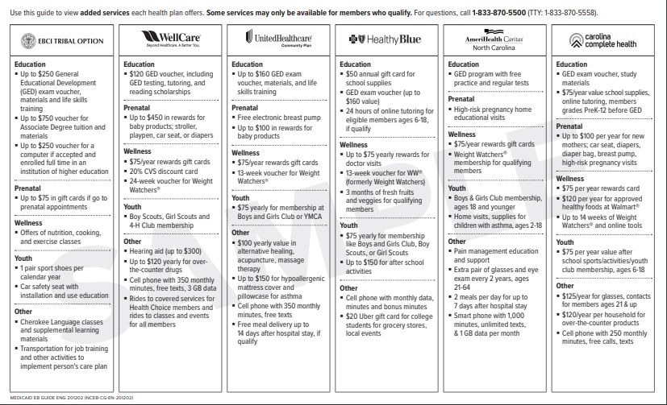
Beneficiary Communication
Health Plan Choice Guide
Samples are available for download in the County Playbook on our website
medicaid.ncdhhs.gov/transformation

Slide 34
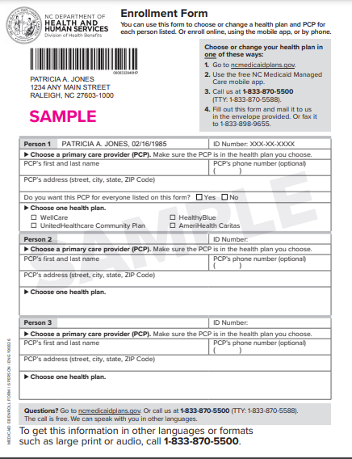
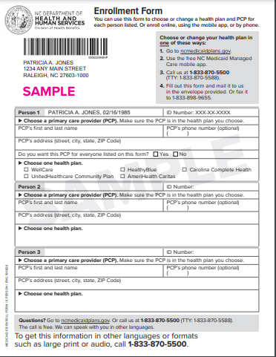
Beneficiary Communication
Enrollment Forms
Samples are available for download in the County Playbook on our website
medicaid.ncdhhs.gov/transformation

Slide 35
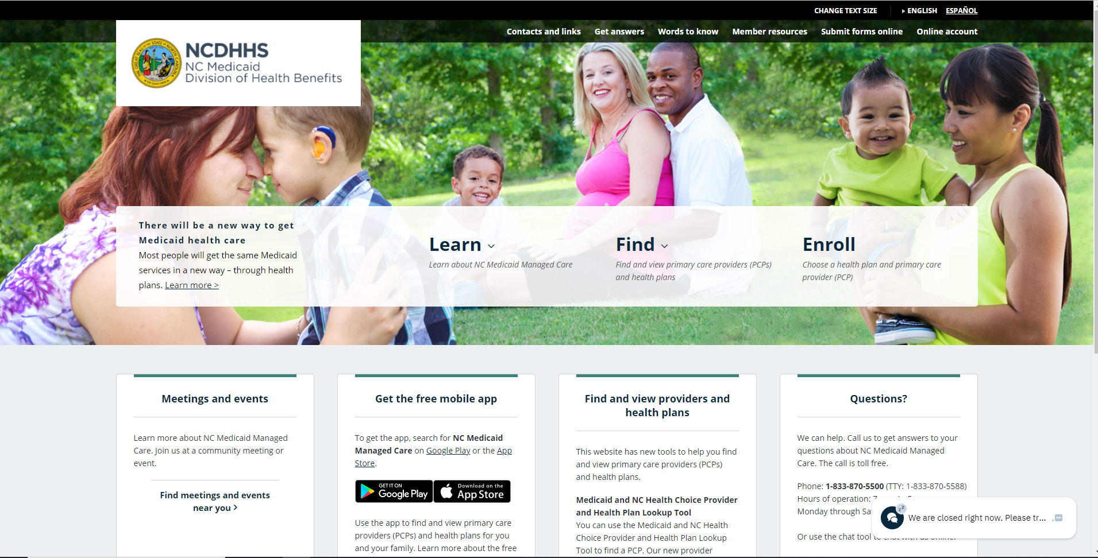
ncmedicaidplans.gov
833-870-5500

Slide 36
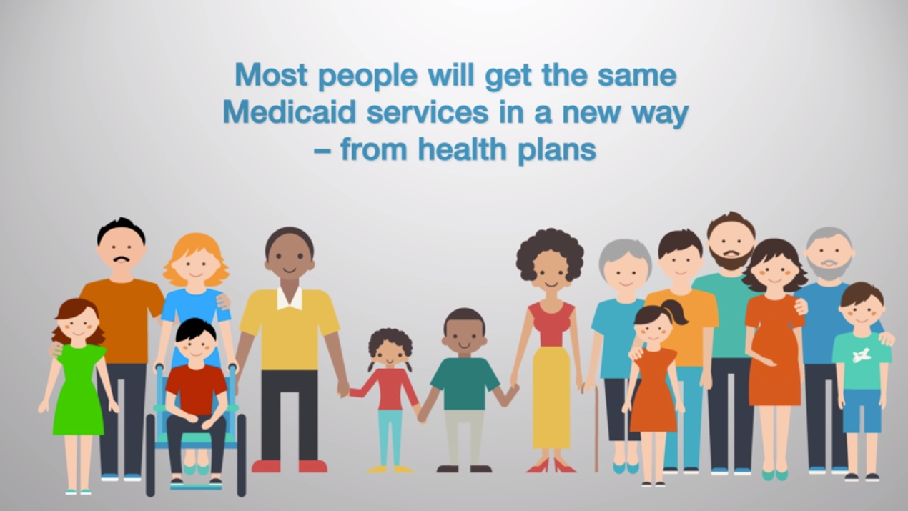
Introductory Video
The NC Medicaid Managed Care Introductory Video addresses
  What is a primary care provider (PCP)?
  What is a health plan?
  The health plans available
  What beneficiaries need to do
  What happens after beneficiaries enroll
  Key dates for enrollment
  How to get answers to additional questions
Notes:
Eric

Slide 37


Partner Engagement & Community Outreach
Partner Engagement Events
Community Outreach Events
Types of Events ​
Community education ​
Virtual Presentation​
Virtual Meet and Greet
Community events​
Virtual Informational meeting
    Types of Events
    Community education
    Virtual Presentation
      Community events
      Virtual Informational meeting
      Virtual Enrollment event
    Types of Materials
      Marketing materials
      Flyers, Fact Sheets, etc.
Types of Materials
Marketing materials​
Flyers, Fact Sheets, etc.
To request a presentation for a community event please email
NCEB_Outreach_Management_Team@maximus.com

Slide 38
Outreach Events Home Page

Slide 39
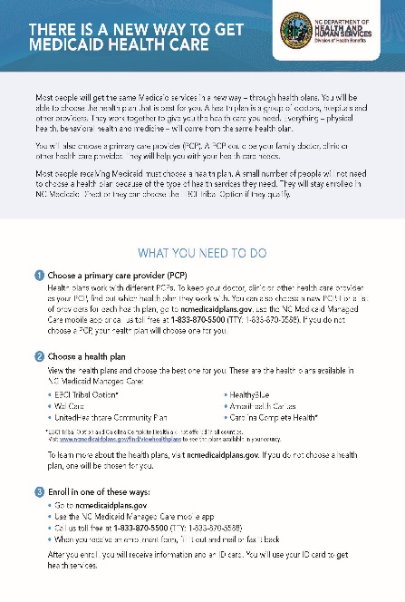
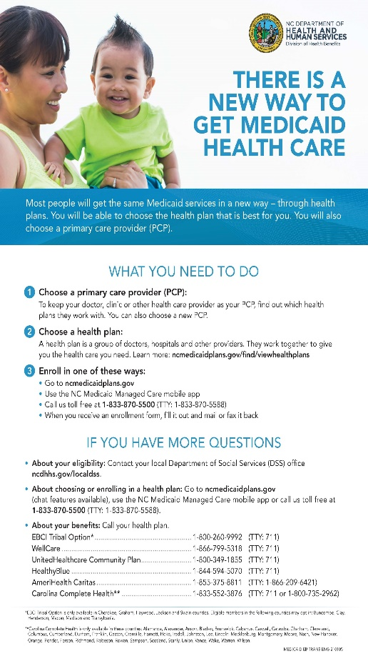
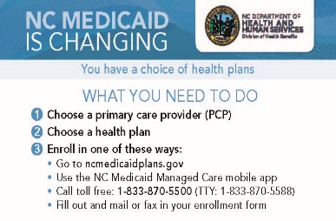
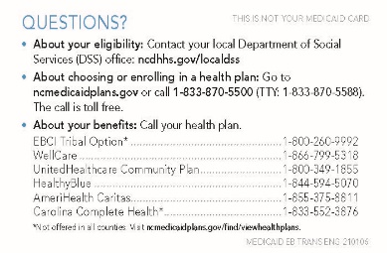
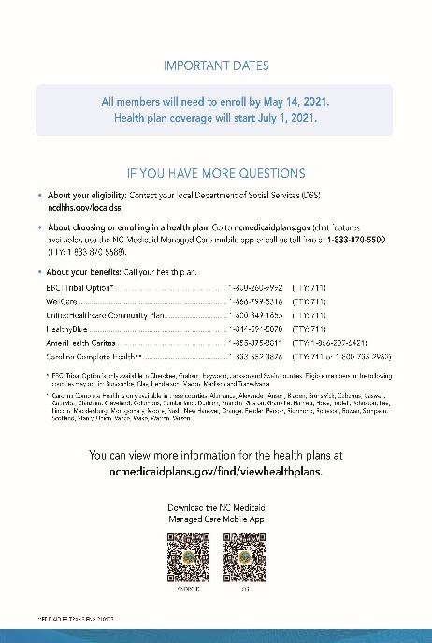
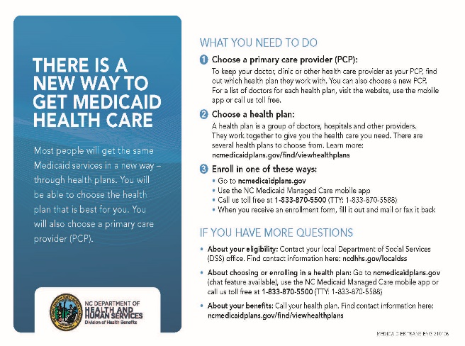
Outreach Materials
FACT SHEET
POSTER
PALM CARD
FLYER
Materials are available for download in the County Playbook on our website
medicaid.ncdhhs.gov/transformation

