Slide 1
Therapeutic Foster Care:
Are we getting what we pay for?

Slide 2
INNOVATIONS IN COLLABORATION TO IMPROVE THERAPEUTIC FOSTER CARE

Slide 3
Good Collaboration

Slide 4
Collaboration is the process of two or more people or organizations working together to complete a task or achieve a goal.
Referral Sources: needed efficiency in referring to multiple agencies
MCO’s: wanted to know how many times a youth moves/disrupts, outcomes of services/EBP’s
TFC Agencies interested in outcomes and comparisons to the Network
Start with common needs to develop a solution……

Slide 5
COLLABORATION BENEFITS
ONGOING MUTUAL PARTNERSHIP B/W PUBLIC & PRIVATE AGENCIES
.
PAY FOR PERFORMANCE
MONTHLY PERFORMANCE REPORT FOR THE MCO OF PROVIDERS SERVING THEIR CATCHMENT
CONTINNUM OF CARE
(BASIC FOSTER, THERAPEUTIC FOSTER CARE, IAFT SERVICE
.
OUTCOMES-INITIAL DATA METRICS AND COLLECTION
MONTHLY PERFORMANCE REPORT FOR EACH PROVIDER

Slide 6
What we set out to do for TFC through Collective Impact & Collaboration
Gather data on certain programs or EBP’s producing better outcomes
Referral streamlining
Identifying a shared vision on “Value” in TFC and larger continuum of care for youth
Understand where & why youth are moving or disrupting placements?
.
This pilot project is based on a shared vision to use data to ascertain effectiveness of Therapeutic Foster Care while impacting the efficiency of referral submission and placement response.

Slide 7
Tackling complex factors within the TFC service array

Slide 8
TFC- Can we collect and analyze outcomes?
How Is value defined in TFC?
-Value Based Payments- can we incentivize Providers to produce better outcomes?
Leverage Technology to streamline referrals and collect data on why youth are not placed
Shared Measurement on data collection
Data driven
treatment
Population Management
Notes:
Incentivize inc
file:///C:/Users/User/Downloads/Value-Based%20Payments%20101%20for%20NASMHPD_FINAL.pdf
Use simple introduction: not overly complicated…..
This presentation will provide participants with an overview of an innovative approach combining the concept of Value Based payments and use of a shared Database to track outcomes and inform Best Practices within Therapeutic Foster Care. Utilizing a partnership between private and public agencies (MCO), data is tracked and youth outcomes are gathered based on a customizable database. This pilot project is based on a shared vision to use data to ascertain effectiveness of Therapeutic Foster Care while impacting the efficiency of referral submission and placement response. Overview of data tracked includes: demographics, placements, length of stay, more detailed discharge information, moves between homes and improvements in performance metrics

Slide 9
TFC
Currently how do we know if the following expectations of the TFC Service Definition are being delivered:
1. Improvement in functioning,
2. Progress (or regression) on treatment goals as identified in the PCP,
3. Stability in the current “TFC Family setting” to ensure continued stay and movement towards discharge criteria .
Notes:
Service definition: treatment? How do you know it is occurring….what are the outcomes….. Service needs to evolved….and meet the current idea of outcomes and pay for performance….

Slide 10
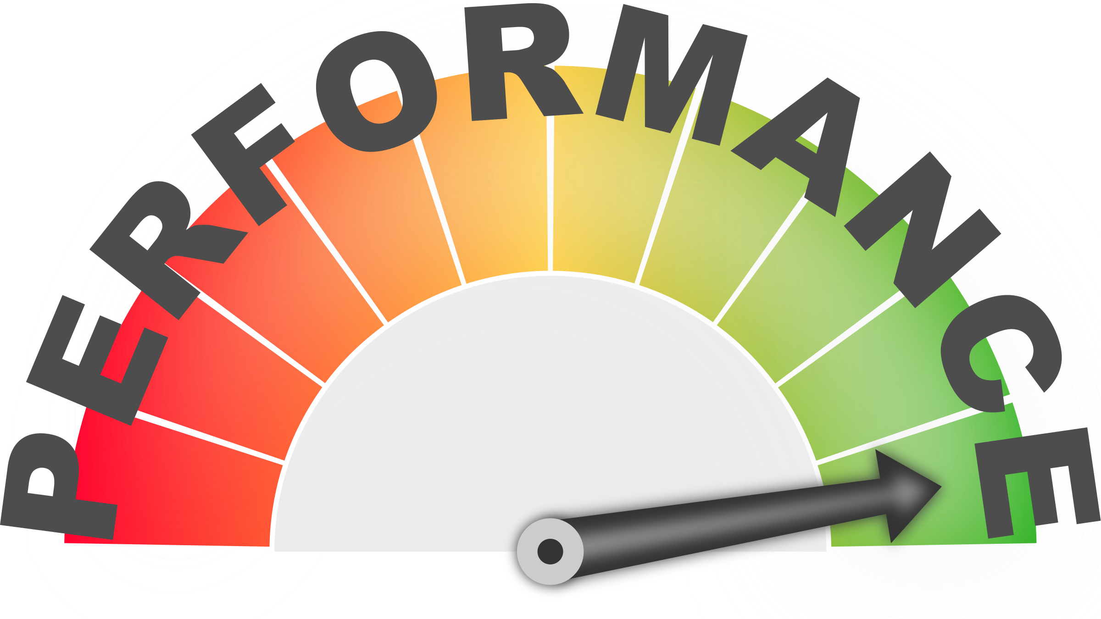
FEDERAL REPORT for Child Welfare
CFSR Report of NC found deficiencies in several areas and the State was issued a Performance Improvement plan to return to “conformity”
-Inability to track placement history which impacts permanency
-Inability to link information regarding placements, permanency planning efforts and intra-agency data.
-No clear method (system) to implement program quality improvement to evaluate improvement measures
-Placement Stability (disruptions)
-Gaps in services for MH needs of children
Notes:
See where it is……add some points about improvement needed

Slide 11
3 FACTORS FOR AN INCREASE IN FOSTER CARE
MORE PARENTS ARE STRUGGLING WITH OPIOIDS AND OTHER DRUGS
MORE JUDGES HAVE RESERVATIONS ABOUT JUVENILE JUSTICE FACILITIES AND MAKE REFERRALS TO CHILD WELFARE (NC RAISE THE AGE CHANGE)
MANY CHILD WELFARE AGENCIES ARE GRAPPLING WITH INADEQUATE DECISION MAKING PRACTICES (INVOLVING MORE PEOPLE/SUPPORTS IN DECISIONS), A LACK OF FUNDING, A LACK OF SUPPORTIVE RESOURCES, NO INFORMED EVIDENCE BASE MODELS USED.
1757 CHILDREN IN TFC IN NC
Notes:
Why the need is present to track outcomes

Slide 12
SOLUTIONS & DATA NEEDED…….
HOW OFTEN ARE CHILDREN MOVED?
WHY ARE MOVES OCCURRING?
IS TREATMENT A REAL FOCUS OF CARE?
DO CHILDREN GO TO A HIGHER OR LOWER LEVEL OF CARE AT DISCHARGE?
WHERE ARE OUR CHILDREN PLACED AT DISCHARGE?
IF WE HAVE THESE ANSWERS WHERE DOES THIS DATA LIVE? HOW EASY IS IT TO EVALUATE ACROSS THE STATE, COMPARE AGENCY TO AGENCY?

Slide 13
Therapeutic Foster Care Referrals and Tracking
Opening the referral database to all TFC placement agencies within a particular MCO catchment, for matching TFC placement and creation of new referrals

Slide 14
Centralized Database
Providing data collection across a continuum of care for youth within the system.
Central database for referrals across BFFC, TFC and IAFT® services
Providing a greater insight into referral demand for MCO management, gaps and service needs.
Demographic tracking for better population management
Tracking lateral moves within individual placement agencies; length of stay; discharge outcomes and nature of discharge

Slide 15
Centralized Database
Additional analysis can be provided through changes in data collection, per request of the MCO
Outcome reports on a regular scheduled basis
Additional data collection oversight to ensure reliable reporting

Slide 16
Goals of the Database platform
Reliable and efficient database to facilitate the placement of youth needing out-of-home placements.
Ease of referral creation
Ease of use for provider/placement agencies
Constant situational awareness for use by the Managed Care Organization
Data Collection, analysis, tools for performance management
Comprehensive Referral and placement process

Slide 17
Referral Streamling
Improved efficiency for referral sources
This Photo by Unknown Author is licensed under CC BY-SA

Slide 18
The Referral process
The Youth
The Referral Source
Youth Requiring out of home placement
Possible referral sources:
Hospital
Crisis center
DSS
IHH Teams
MCO Care Coordination
Other Mental Health Providers
Individuals, family members

Slide 19
The Referral process
Placement Agency
Placement Agencies providing out-of-home services
Opening the database to a larger number of CPAs will increase the likelihood of appropriate matching
MCO
Placement Agency
Placement Agency

Slide 20
The Referral process
An account with the “public” database can be made by any stakeholder.
The Initial referral is made
Referral receives its referral ID
The Referral Source
REF_ID 32000

Slide 21
The Referral process
Placement Agency
MCO
Placement Agency
The Referral alert is sent to the participating placement agencies.
MCO representatives will have access to look at and monitor referrals within their catchment.
The Referral Source
REF_ID 32000
REF_ID 32000
REF_ID 32000
REF_ID 32000
Placement Agency

Slide 22
The Referral process
All Beds Full
Placement Agency
MCO
Placement Agency
Maybe
Initial Responses are entered
The Referral Source
Yes
Placement Agency

Slide 23
The Referral process
All Beds Full
Placement Agency
MCO
Placement Agency
Maybe
Initial Responses are entered
The Referral Source
Yes
Placement Agency

Slide 24
The Referral process
MCO
Yes
Placement Agency
Placement agency and Referral source start initial placement details through traditional communications
The Referral Source

Slide 25
The Referral process
Yes
Placement Agency
MCO
The purpose of the CCW referral database is a signaling for need of care. The intention is not to supersede clinical decision making.
In the event more than one agency responds positively to a referral, clinical decisions for placement is made by collaboration between CPAs, the referral source, and MCOs.
Placement Agency
Yes
The Referral Source

Slide 26
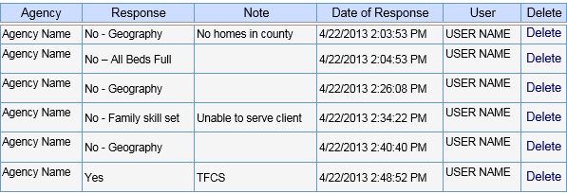
MCO Monitoring
Real-time responses from agencies
Notes:
Try to change out graphic for 2018 TFC responses

Slide 27
Sample Report

Slide 28
Performance Management, Analysis, and Reporting
Metric Tracking:
Response Times
Referral to placement time
Placement and discharge, length of stay
Demographic Data mining
Discharge outcomes (where the youth is being discharge to)….treatment success/PCP goal success
Tracking of lateral home moves within provider agencies

Slide 29
Data gives us a look into the following ……
1. clear look at where consumers discharge to, 2. gap analysis….where services are needed 3. performance level of providers 4. success of tx. efforts (were goals achieved) 5. outcomes for a number of metrics required by the MCO
(we can customize what is needed) 6. success rate of consumers—which providers seem to get the best results 7. total of consumers in care and the number and location of homes

Slide 30
Questions & Answers
Danny Nolen
dnolen@ncrapidresource.org
1-704-516-4870

